Slide 1

Online Assessment System Using AI-Based Monitoring
by
B. GEETHIKA
Roll No. 224G1A0520
K.VISHNUVARDHAN
Roll No. 224G1A05C5
J. LAKSHMANJI
Roll No. 224G1A0539
Under the guidance of
Mr. M. Narasimhulu, M.Tech(Ph.D)
Assistant Professor
Department of Computer Science and Engineering
Srinivasa Ramanujan Institute of Technology
Autonomous
Rotarypuram Village, B K Samudram Mandal, Ananthapuramu – 515701.
2025-2026

Slide 2
Contents
Title Justification
Abstract
Problem statement
Objectives of Project
Literature survey for objectives
Proposed Work -(Methods to be followed for proposed system)
References
GitHub Link
Queries

Slide 3
Title Justification
The title “Online Assessment System using AI-Based Monitoring” clearly describes the purpose of this project. It is an online exam platform that uses artificial intelligence to monitor candidates in real time. The system applies face recognition and behavior analysis to detect cheating, impersonation, and unauthorized activities during examinations. Therefore, the selected title accurately represents the system’s functionality and goal of maintaining a secure and fair assessment process.

Slide 4
Abstract
The rapid rise of online education has increased the need for secure and reliable assessment systems. Many existing online exam platforms lack proper monitoring, which leads to cheating, impersonation, and other unfair practices. To address this problem, this project proposes an “Online Assessment System using AI-Based Monitoring”, which uses face recognition and real-time behavior analysis to verify student identity and detect suspicious activities during the exam. The system provides different roles for administrators, faculty, and students, making it easier to manage, conduct, and monitor exams securely. As a result, it helps in reducing malpractice and ensures a fair, transparent, and trustworthy online examination process.

Slide 5
Problem Statement
Ensuring integrity in online examinations is a persistent challenge due to weaknesses in current assessment systems. Many platforms lack effective mechanisms to verify student identity or detect dishonest behavior, making them vulnerable to cheating and impersonation. Reliance on manual supervision is not only inefficient but also difficult to enforce remotely. Therefore, there is a need for a robust AI-based online assessment system that can authenticate students reliably, monitor their actions in real time, and prevent malpractice, ensuring a secure and credible examination process.

Slide 6
Objectives of Project
Research Objective 1:
To develop an AI-based system for authenticating students and monitoring their behavior during online examinations.
Research Objective 2:
To evaluate the effectiveness of the AI system in preventing malpractice and ensuring fairness in online assessments.

Slide 7
Literature survey for objectives
No | Title | Authors | Journal Name & Year | Methodology Adapted | Key Findings | Gaps
1. | Cheating Detection and Prevention Techniques in Online System for University Examinations | Narender K and Harish R | International Research Journal on Advanced Engineering Hub(IRJAEH)-2024 | Biometric authentication, Network monitoring | Combining techniques increases effectiveness | Review only; no real-time AI, no mobile/object detection
2. | AI-based diagnostic assessment integrated with a knowledge map | Chia‑An Lee, Nen-Fu Huang, Jian-Wei Tzeng and Pin-Han Tsai | IEEE Transactions on Learning Technologies-2023 | AI-based diagnostic assessment with knowledge map | Can see which topics students know well or not; helps personalize learning | Knowledge map must be made manually; needs good data; does not stop cheating
3. | Multimodal Biometric Authentication for a Computer-Based Test (CBT) Application | Desmond Bala Bisandu, Akos Shalom, Farouk LawanGambo | International Research Journal of Computer Science (IRJCS)-2020 | Face recognition + other biometrics at login | Stops impersonation; ensures correct student starts exam | No monitoring during exam; cannot detect cheating; depends on camera/biometric quality

Slide 8
Proposed System
The proposed system uses AI-based monitoring to ensure secure and fair online exams by verifying identity and detecting malpractice in real time.
Key Features:
1.Real-Time Monitoring: Tracks student activity, including face detection and behavior.
2. Identity Verification: AI-based facial recognition prevents impersonation.
3. Malpractice Detection: Detects cheating, mobile usage, or unauthorized presence.
4. Automated Exam Management: Faculty can create, schedule, and manage exams and results.
5. Alerts & Notifications: Sends real-time alerts for suspicious activities.

Slide 9
References
[1] Narendra K and Harish R “Cheating Detection and Prevention Techniques in Online System for University Examinations: A Comprehensive Review,” International Research Journal on Advanced Engineering Hub (IRJAEH), Volume 02, Issue: 09 September 2024.
[2] Chia-An Lee, Nen-Fu Huang, Jian-Wei Tzeng and Pin-Han Tsai, “AI-Based Diagnostic Assessment System: Integrated With Knowledge Map in MOOCs,” IEEE Transactions on LearningTechnologies, Volume 16, No. 5, October 2023.
[3] Desmond Bala Bisandu, Akos Shalom and Farouk LawanGambo, “Multimodal Biometric Authentication for a Computer‑Based Test (CBT) Application,” International Research Journal of Computer Science, Volume VII,179-196, Issue:16 July 2020.

Slide 10
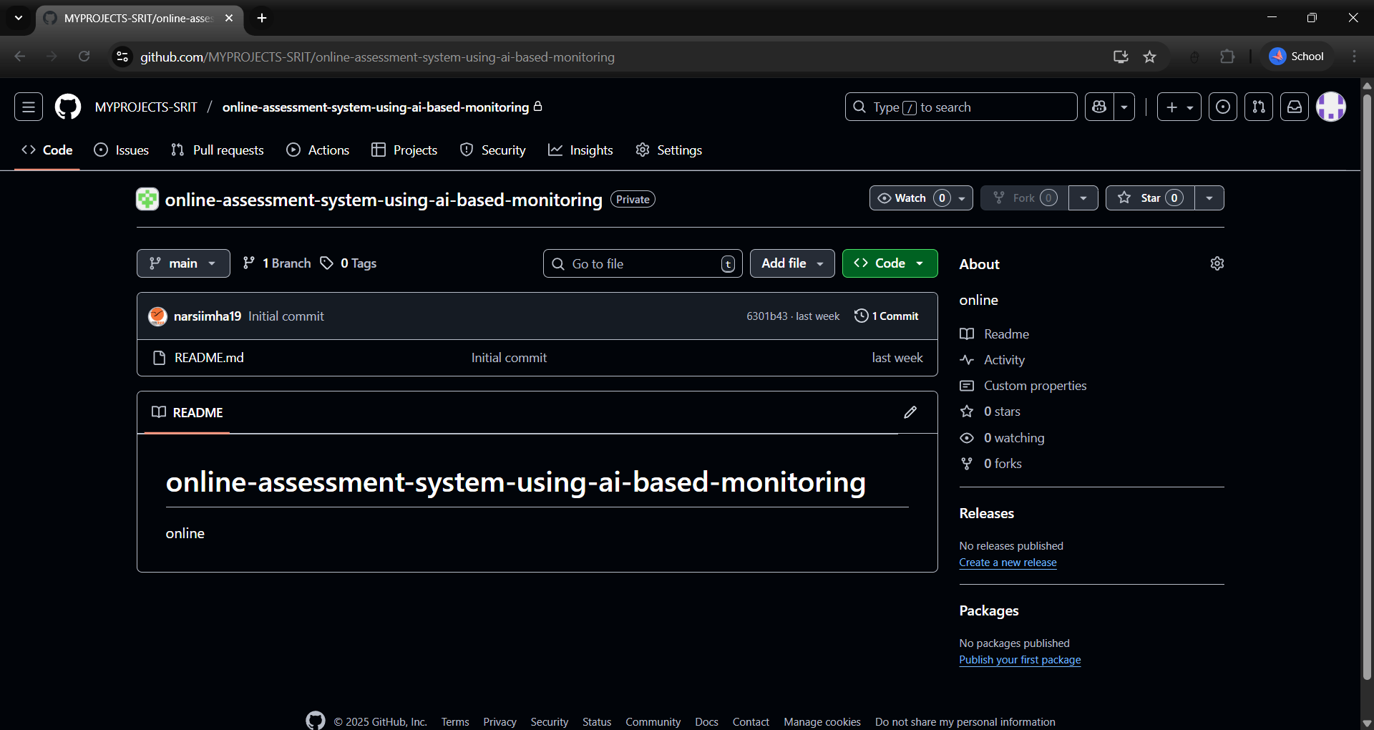
Git Hub Dashboards of each student
Github link: https://github.com/MYPROJECTS-SRIT/online-assessment-system-using-ai-based-monitoring

Slide 11
Any Queries?

